Slide 1

New Plants for 2021
Annuals, Perennials, Shrubs and Trees

Slide 2
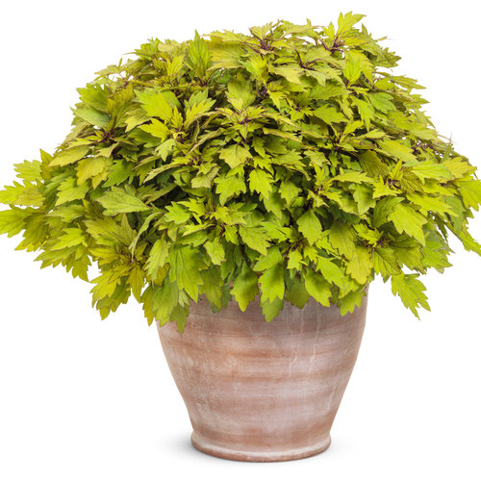
ColorBlaze® Royal Pineapple Brandy™
Coleus
This jazzy new Coleus for sun and shade features yellow to chartreuse luminescent foliage with accents of burgundy bronze, forming a very well-branched plant that works well in landscapes and containers. Like all ColorBlaze® Coleus, it is bred to take the heat and bloom very late in the season, if at all, extending its garden performance into the fall.
Height: 20-30”
Width: 12-16”
Deer Resistant

Slide 3
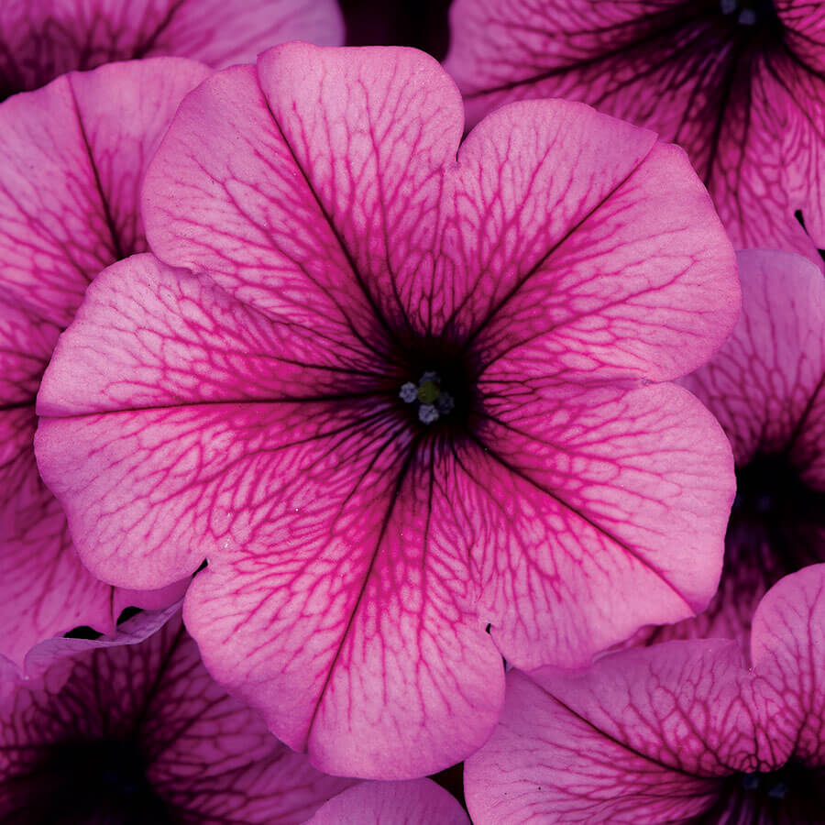
Petunia spreading Easy Wave Rose Fusion
Petunia spreading Easy Wave Rose Fusion Exceptional uniformity and well-matched habit plus the widest color range make Easy Wave the most versatile large-flowered spreading petunia series. The new Rose Fusion shows mid-rose blooms with deep rose veins.
Garden height: 6-12”, spreading 30-36

Slide 4
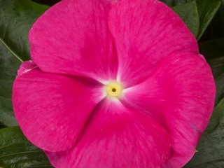
Vinca Cora Cascade Bright Rose
Vinca Cora Cascade Bright Rose Featuring the same disease resistance and vigor of the Cora series along with a mounding and trailing habit. Wonderful as a landscape plant or in baskets. Thrives in heat and humidity. The new Bright Rose has beautiful hot pink flowers.
Garden height: 6-8”.

Slide 5
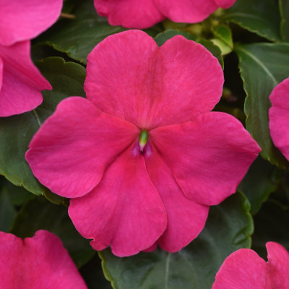
Impatiens 'Beacon Rose' Beacon Impatiens
Impatiens 'Beacon Rose' Beacon Impatiens exhibit high resistance to impatiens downy mildew. Offers season-long color to gardens and landscapes. Rose adds a new color to the series.
Height: 10 - 12" (25 - 30cm)
Width: 12 - 14" (30 - 36cm)
‍Spacing: 8 - 10" (20 - 25cm)
‍Exposure: Shade, Partial Sun, Sun

Slide 6
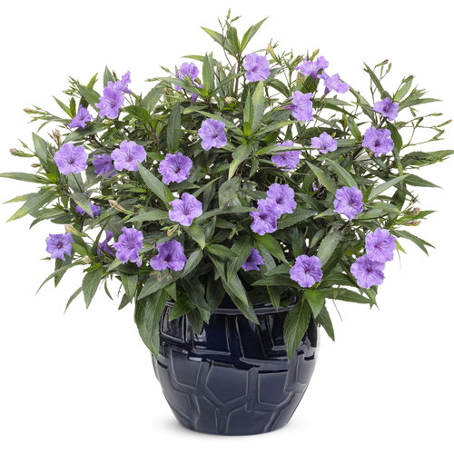
Machu™ Morado Mexican Petunia
Ruellia simplex
This plant is great for hot climates and flowers prolifically when nights are warm and days are hotter. In climates where night temperatures are nice and cool, flowering will be sparse.
Continuous Bloom or Rebloomer. Deadheading Not Necessary. The flower is periwinkle looking.
Height: 18-32”
Spread: 10-18

Slide 7
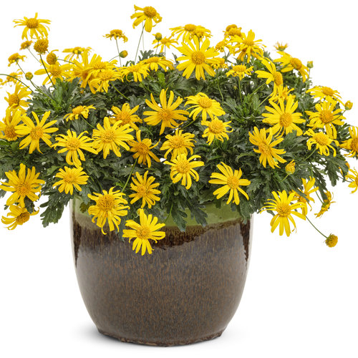
High Noon® Bush Daisy
Euryops pectinatus
Bright yellow, daisy flowers. Very heat tolerant and drought tolerant once established.
Attracts: Bees and butterflies. Continuously reblooms and is long blooming
Maintenance Notes
Easy to care for. Use a controlled release fertilizer at the time of planting, which should be sufficient for the season. Trim if needed to shape. Deadheading is not necessary. This plant is drought tolerant once established in the garden.
Uses Notes
Great in landscapes and containers.

Slide 8
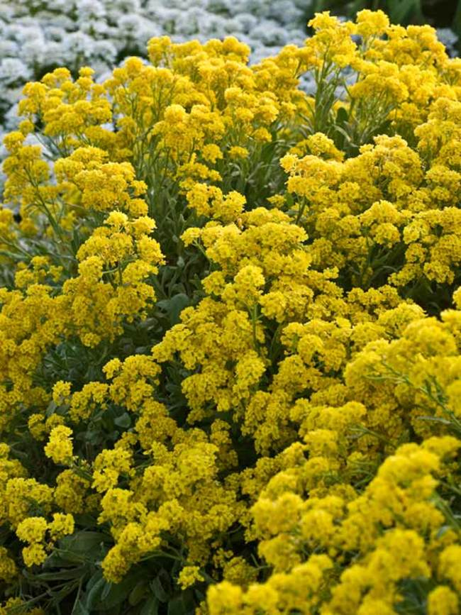
Alyssum Saxatile ‘Summit'
Spring flowering mounds of bright yellow over gray-green foliage. Low, wide growth is excellent cascading over a wall or along the border's edge. A prolific bloomer, plant in masses for best effect. Golden Yellow is an improved selection with excellent disease resistance. Cut back by a third after flowering to improve appearance. Do not cut back in fall, as plants are semi-evergreen.
Height: 8” Spread: 12-18”
Zone 3-7

Slide 9
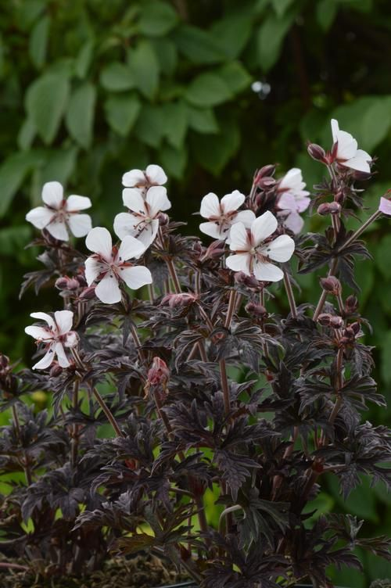
Geranium ‘Midnight Ghost'
The dark purple foliage of Midnight Ghost will offer a haunting presence in the garden, sparkling clear white flowers will bloom all summer long and stand out against the dark leaves. It can tolerate dry soil conditions.
Great for dry soil in shade.
Height: 6-8” Spread: 12-36”
Zone: 3-8

Slide 10
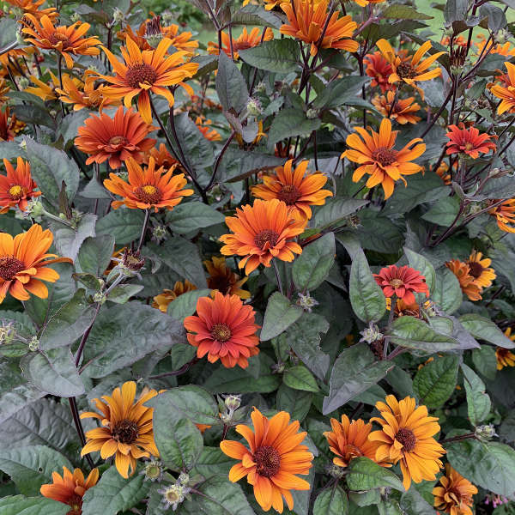
Heliopsis helianthoides 'Scabra Burning Hearts'
Prized as the first seed strain of Heliopsis without yellow on its flowers, this blooms from July until frost. The new flowers emerge intense orange red and mature to golden orange with red centers. Deep green leaves with bronze highlights and black flower stems complete the look. A taller plant suitable to the middle or back of the border.
Height: 36-40” Spread: 36-40”
Zone: 3-9

Slide 11
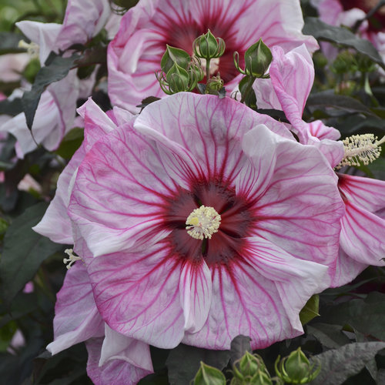
Hibiscus ‘Cherry Choco Latte'
'Cherry Choco Latte' is a brand new, long blooming Hibiscus with a smaller size that is more suitable for tighter spaces. Very large, 8-9" three-dimensional flowers are white with intense deep pink veining and a notably large red eye. Attractive dark olive green foliage has bronze highlights and forms a compact clump, with flowers covering the entire habit later in the season.
Height: 4’ Spread: 4’
Zone: 4-9

Slide 12
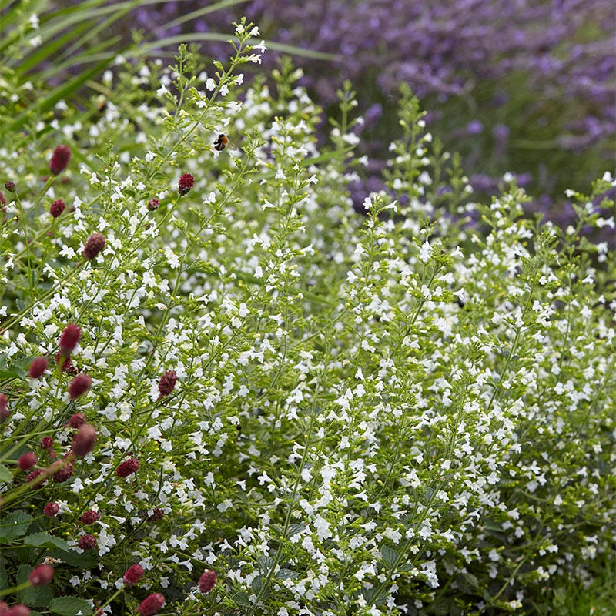
2021 Perennial of the Year—
Nepeta 'Calamintha'
Calamintha creates a serene, inviting space with clouds of tiny white blossoms and dense, finely textured foliage that releases a rejuvenating minty fragrance. Flowering from early summer until fall, Calamintha attracts a host of pollinators. Drought tolerant plants spread gently and will drape over the edges of containers and rock walls, softening hard edges as a lovely filler, edging plant, or groundcover. Deer resistant.
Height: 12-18” Spread: 12-24”
Zone: 5-7

Slide 13
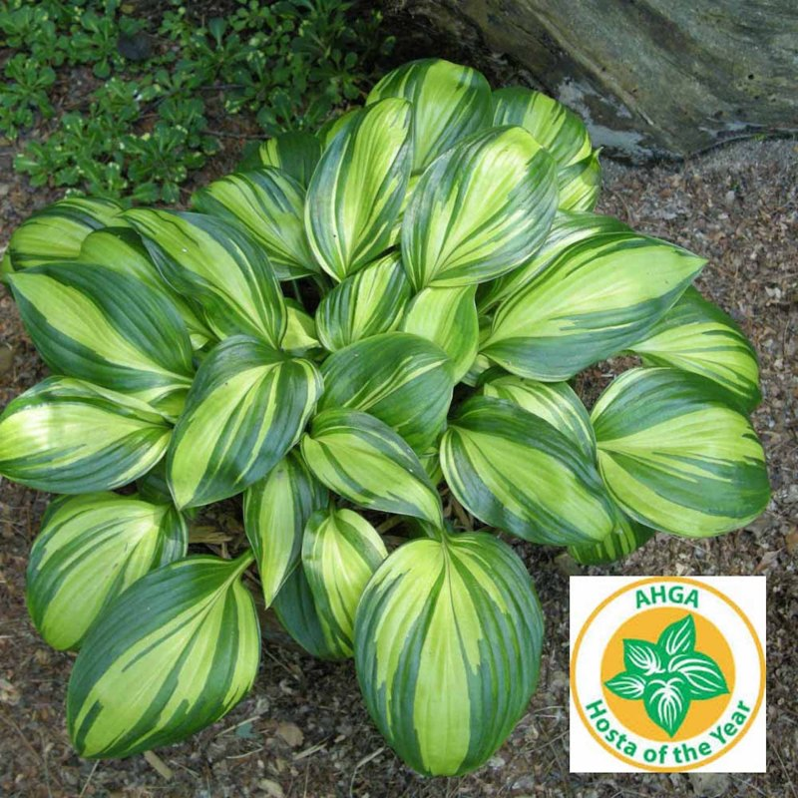
2021 Hosta of the Year—Rainbow’s End
This unique hosta exhibits incredibly variegated, shiny foliage. The bright yellow leaves of good substance have dark green margins that jet into the center, and the center brightens to creamy white in summer. It forms a medium sized mound of attractive foliage in the landscape.
In late summer, showy red scapes carry the dark lavender, tubular flowers.
Height: 11” Spread: 21”
Zone: 3-9

Slide 14
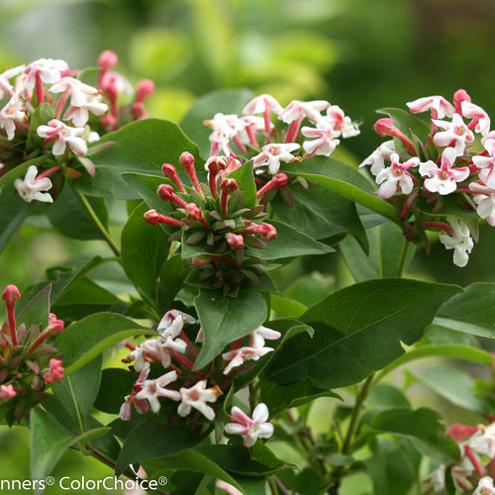
Abelia 'Sweet Emotion'
Sweet Emotion abelia is the most fragrant of any abelia, with white and pink spring blooms that perfume the air with the scent of jasmine when it blooms in spring
Tolerates part shade; resists deer and rabbits.
Height: 5-6’ Spread: 5-7’
Zone: 4-8

Slide 15
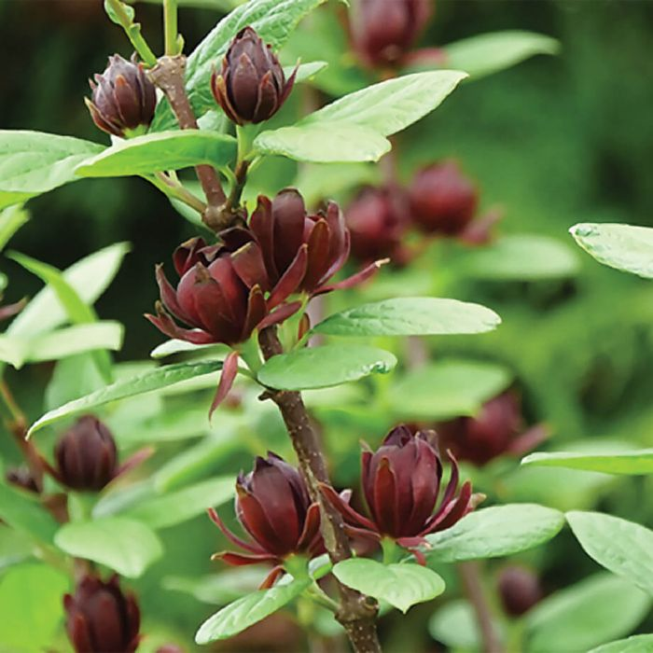
Calycanthus ‘Simply Sensational'
The nicest smelling native on the market! Simply Scentsational® calycanthus is the most intriguing scent you'll find in any garden. Debate amongst your friends and relatives whether it's melon, banana, strawberry, or even Juicy Fruit gum that your nose is picking up Impressive show of large burgundy blooms from spring into summer.
Height: 6’ Spread: 4-5’
Zone: 4-9

Slide 16
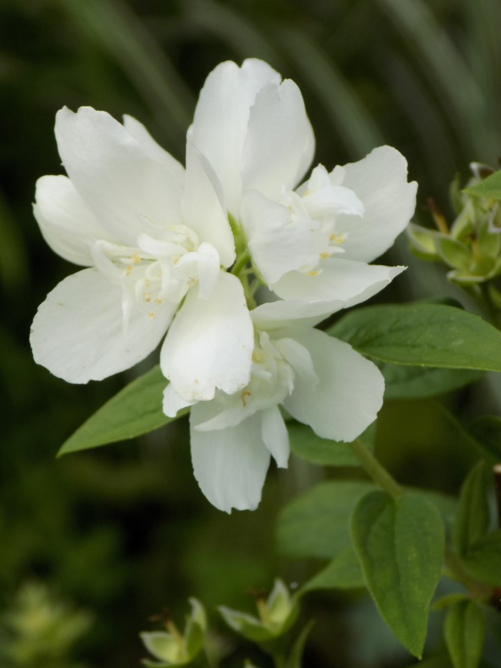
Mockorange ‘Snowbelle'
Add a sweet, citrus fragrance to your garden with this compact shrub. The double blooms are refreshing, both in fragrance and bright white color. They appear all over gracefully arching stems which adds a sophisticated, formal touch to the landscape. With its compact habit, it's a good choice for smaller gardens, in mass plantings or as part of a hedge. Snowbelle is a slow and steady grower, and becomes more impressive every year. You may not have many flowers in the first blooming season, but the abundance of mid to late spring blooms in the coming years are worth the wait.
Height: 3-4’ Spread: 3-4’
Zone: 4-8

Slide 17
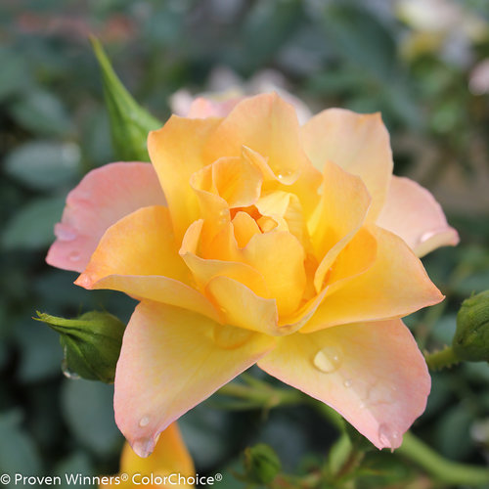
Oso Easy ‘Italian Ice’ Rose
Similar to 'Peace' in its coloration, the orange buds of Oso Easy Italian Ice® rose open to soft yellow flowers melting into pink blushed margins. The soft flower color is set off nicely by its dark green, glossy foliage. Flowers are semi-doubled, with 24-30 petals per bloom. This self-cleaning rose has excellent disease-resistance, abundant flowers, and a nice habit, making it an excellent plant for home gardens.
Height: 18-30” Spread: 18-30”
Zone: 4-9

Slide 18
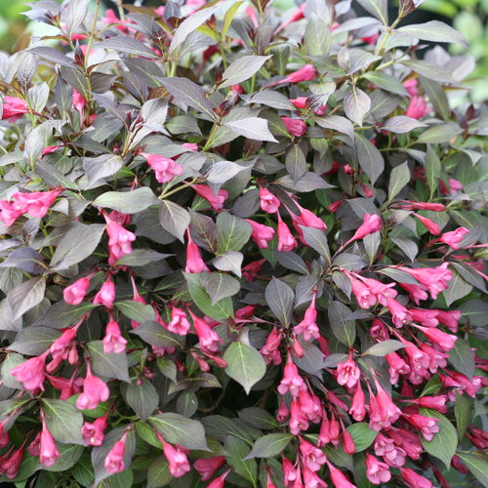
Weigela 'Midnight Wine Shine'™
If you grew Midnight Wine®, it's time to switch to Midnight Wine Shine™. This is an improved selection with darker, extremely glossy foliage. Its parentage comes from the Canadian variety 'Tango', so it has excellent hardiness and is less prone to tip dieback. While its flowers are a bit better than Midnight Wine, the plant is grown for its attractive foliage and habit.
Height: 1-1 ½’ Spread: 2-2 ½’
Zone: 4-8

Slide 19
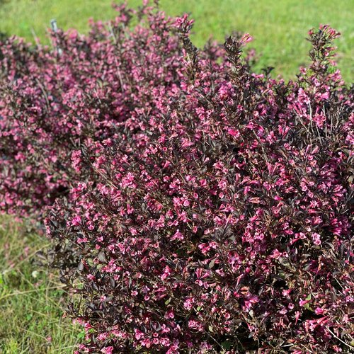
Weigela ‘Very Fine Wine'™
This compact Weigela has more vivid and prolific hot pink flowers and deeper darker foliage. VERY FINE WINE® grows 2-2 ½’ high and wide making it great for the front of the mixed border or foundation planting and due to its compact size, is an excellent choice for containers. The tubular shaped spring blooms will attract Hummingbirds, but deer will keep walking right on by!
Height: 2-3’ Spread: 2-3’
Zone: 4-8

Slide 20
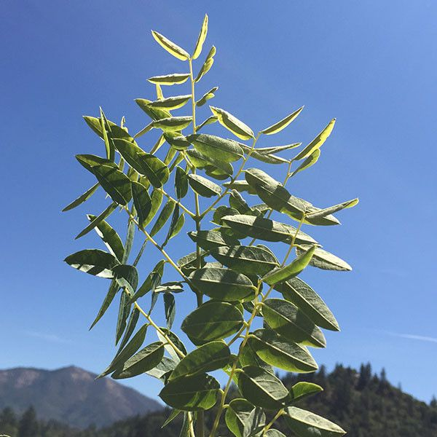
Skinny Latte™ Kentucky Coffeetree
Stiffly upright structural branches ascend vertically to form a remarkably narrow canopy and unique winter silhouette. Originating from a seedling acquired by the Morton Arboretum in 1958, the unique selection is an introduction of ChicagolandGrows®
Height: 50’ Spread: 18’
Zone: 4

Slide 21
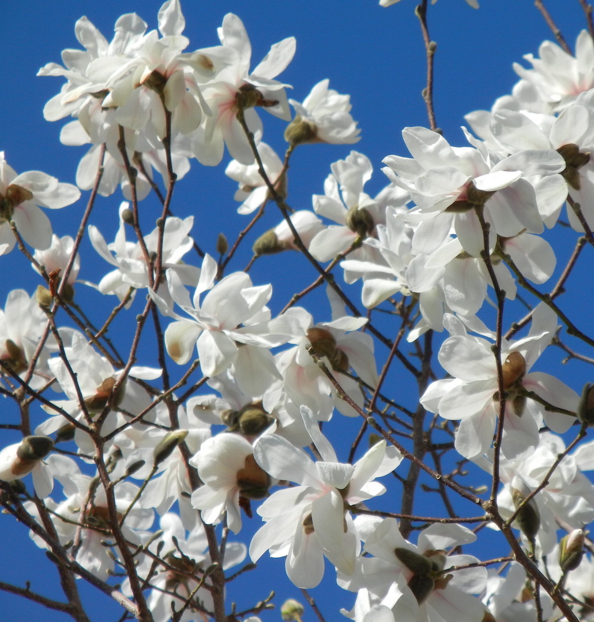
Spring Welcome® Magnolia
Outstanding pest-free winter hardy selection of magnolia that blooms reliably even after early spring
frosts. Spring Welcome® is dense, well branched with flowers that are pale pink in bud, gradually opening to pristine white. Fall color is yellow-green to bronze.
Height: 20’ Spread: 20’
Zone: 3-7

Slide 22
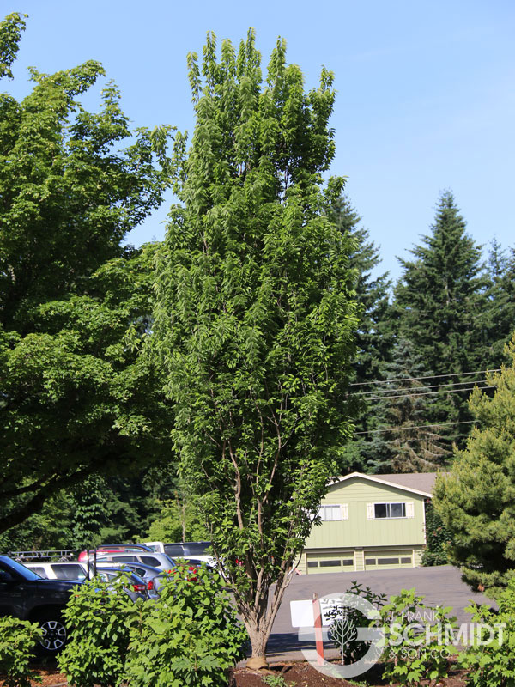
'Prairie Sentinal'® Hackberry
Prairie Sentinel Hackberry is a deciduous tree with a narrowly upright and columnar growth habit. Its relatively coarse texture can be used to stand it apart from other landscape plants with finer foliage. This tree will require occasional maintenance and upkeep. It is best pruned in late winter once the threat of extreme cold has passed.
Height: 30-50’ Spread: 10-15’
Zone: 4-7

