Slide 1
New Plants for 2022
Annuals, Perennials, Shrubs and Trees

Slide 2
Angelissa Rose™ Angelonia
Angelonia
This Angelonia features large flower spikes and strong sturdy stems. It has an outstanding rose flower color. The foliage remains bright green throughout the entire summer. Attracts butterflies, bees, and hummingbirds. Heat tolerant. Fragrant flowers. It will take full and part sun.
Height: 12-16”
Width: 10-12”

Slide 3
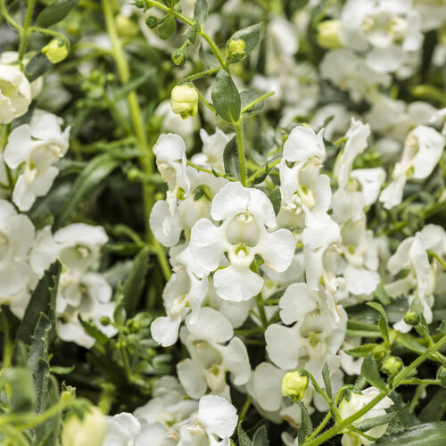
Angelface Cascade Snow Angelonia
Angelonia will tolerate wet feet and a fair amount of drought. The plants are easy care with no deadheading needed. It flowers best in the heat. This one has a mounding trailing habit.
Height: 8-14”
Spread: 12-30”

Slide 4
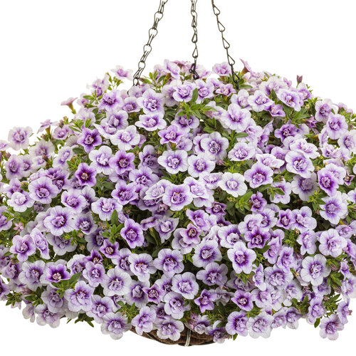
Superbells Double Twilight
Calibrachoas are usually easiest to grow in containers but can also be in-ground. They do not require deadheading. This variety has beautiful lavender color with a dark eye. They can take part sun to full sun.
Height: 6-12”
Spread: 12-24”

Slide 5
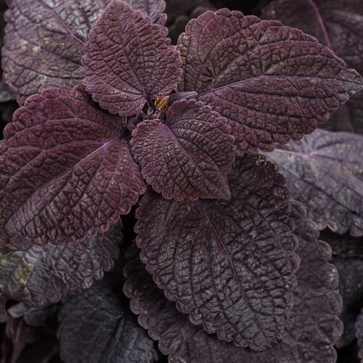
ColorBlaze® Newly Noir™ Coleus
Newly Noir has a deep purple to black foliage and is a wonderful plant for both sunny and shady spots. It is adaptable as a houseplant. It is heat tolerant. Low maintenance.
Height: 24-40”
Spread: 18-36”

Slide 6
ColorBlaze® El Brighto™ Coleus
This Coleus has beautiful variegation of red, yellow and orange. Very striking contrast. It can tolerate sun or shade. It is also heat tolerant.
Height: 18-36”
Spread: 18-36”

Slide 7
ColorBlaze® Torchlight® Coleus
And yet we have another striking combination of color with this Torchlight Coleus. The tricolor foliage of fuchsia, maroon-purple and green is wonderful. It will also tolerate sun or shade and is heat tolerant.
Height: 24-40”
Spread: 18-36”

Slide 8
Suncredible® Saturn™ Sunflower
This everblooming sunflower is built on a well branched bush-like habit that is perfect for the back of beds. The blooms are about 4” across and do not need to be deadheaded to continue blooming but can be groomed for tidiness. Makes great cut flowers. It is drought tolerant.
Height: 2-3’
Spread: 20” to 3’

Slide 9
Kelos™ Fire Orange Celosia
Fire Orange has robust, compact foliage combined with vibrant color. Electrifying plumes hold their color through the heat of summer and continue into fall.
Height: 12-20”
Spread: 15-20”

Slide 10
Heart to Heart® Burning Heart Caladium
‘Burning Heart’ is a bronze fancy leaf variety with pink to orange spots. It works well in combination and patio planters. It will also take shade or full sun; however, its full rich color is expressed best in sun. It can also be adapted as a houseplant.
Height: 15-20”
Spread: 10-14”

Slide 11
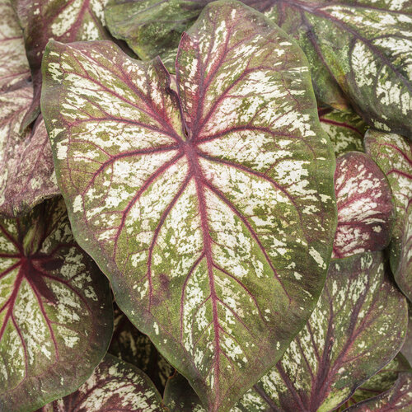
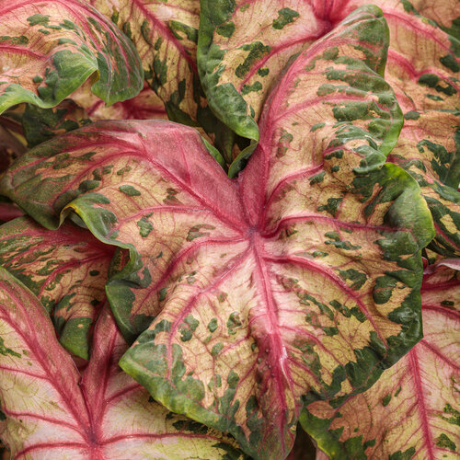
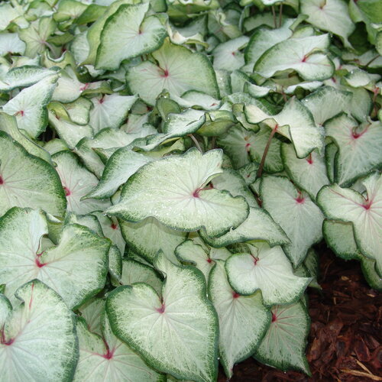
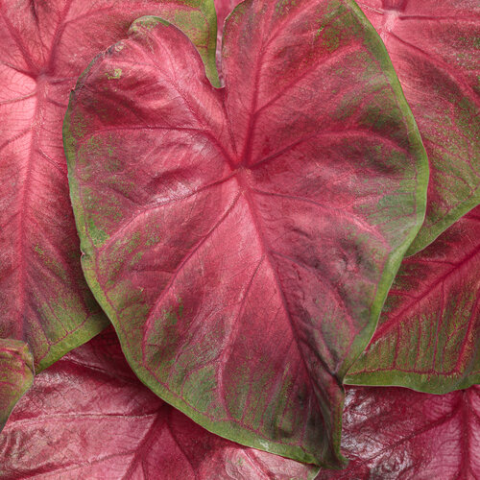
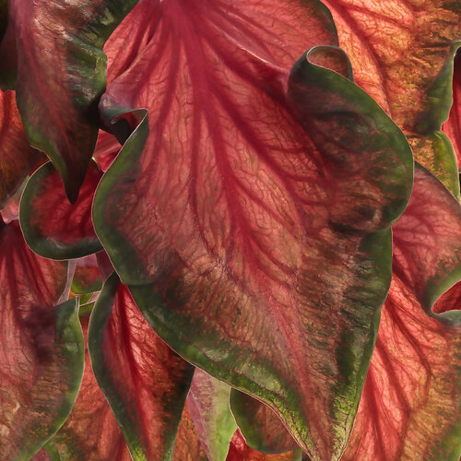
Explosion
Clowning Around
White Start
Hot Flash
Hot 2 Trot

Slide 12
Lavender Bubbles Allium PP31126
Nearing the end of summer, this beautiful perennial brings life to a garden with its beautiful bubble-shaped flowers. Dark dust purple flower globes are produced above attractive glaucous blue-green foliage. The leaf blades twist and curl to provide additional interest.
Height: 12-14”
Spread: 20-22”
Zone: 4-8

Slide 13
Feathered Friends™ ‘Parrot Paradise’ Bugleweed (Ajuga)
This ajuga will have you dreaming of a tropical sunset. Foliage takes on hues of yellow, orange, and red, creating a colorful display that lasts all season long. Plus, wavy leaf margins add extra texture to the understory.
Height: 4”
Spread: 18”
Zone: 4-9

Slide 14
2022 Hosta of the Year—Island Breeze
First came ‘Fire Island’ which was followed by its variegated progeny ‘Paradise Island’. Now there is ‘Island Breeze’ which is the third member of this “tropical” family and a sport of “Paradise Island. This cultivar includes more impressive variegation due to its wider margins, thicker leaf substance, and a strong growth rate. The wide, dark green margins stand in sharp contrast to the bright yellow center in early spring. They become more chartreuse when plants are grown in heavier shade or lighter yellow if they are in more sun.
Height: 12” Spread: 18”
Zone: 3-9

Slide 15
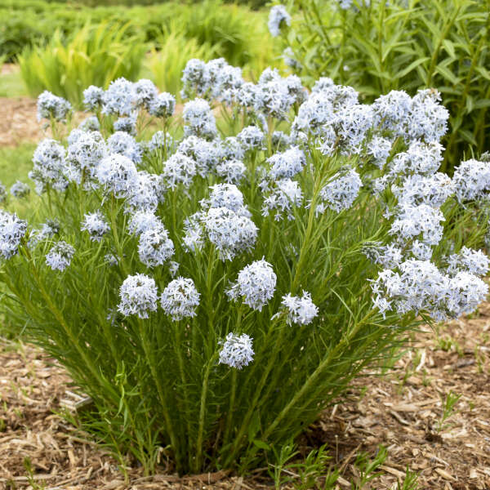
Amsonia String Theory
String Theory can be described as a compact version of Amsonia hubrichtii. The compact habit is covered in light periwinkle blue flowers in late spring, flowering later than “Storm Cloud’ and continues to display healthy dark green leaves throughout the summer. It has brilliant golden orange fall color.
Height: 18-22”
Spread: 32-36”
Zone: 4-9

Slide 16
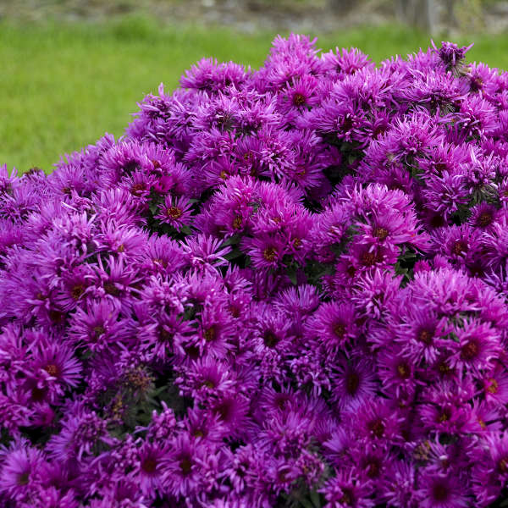
Aster Grape Crush and Pink Crush
Grape Crush produces a large, very round mound with densely packed flowers. There are very rich, dark purple flowers produced above dark green foliage in early fall to midfall. It makes for great late season bloom in the perennial garden. Pink Crush is vibrant pink in color, but a little shorter in stature.
Height: 26-30”/20-24” Spread: 40-44”/34-38”
Zone: 3-8

Slide 17
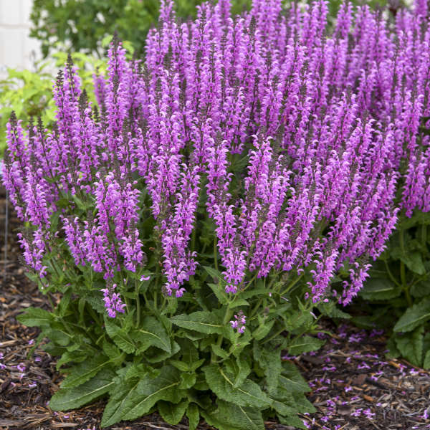
Back to the Fuchsia Salvia
Back to the Fuchsia produces fuchsia pink flowers on dark charcoal stems. Flowers are produced prolifically above a canopy of dark green leaves. They will rebloom if cut back after first bloom. They are deer and rabbit resistant. Attracts butterflies, hummingbirds, and bees.
Height: 22-24”
Spread: 22-24”
Zone 3-8

Slide 18
Rain Dance Clematis
This is a bush clematis with flowers as large as 2 ½-3”, outward facing, indigo blue in color with darker midribs and lighter margins. This plant will benefit from support of staking, a garden obelisk or from neighboring plants, as it does not vine.
Height: 42” Spread: 30”
Zone: 3-7

Slide 19
Reminiscent Pink™ Rose
This rose combines classic beauty and fragrance of old-fashioned roses with modern-day performance. They were developed to bring out the best in color, fragrance, petal count, and flower power.
Blooms all summer without deadheading.
Full Sun
Height: 3-4’ Spread: 2’
Zone: 4-9

Slide 20
Weigela ‘My Monet Purple Effects'™
This weigela has hues of cream, green, and pink, layered with a cast of purple. It has a dwarf habit and neat, variegated foliage like the original My Monet weigela, but is exceptionally strong flowering.
Exposure: Full sun, part shade.
Height: 1.5-2.5’ Spread: 1.5-2.5’
Zone: 4-6

Slide 21
Ringo® Rose
This hybrid rose opens with a bright golden yellow with a blazing red center. They mellow to a soft yellow, before finally turning white with a distinct pink center. Attracts pollinators, disease resistant, and is a rebloomer.
Exposure: Full Sun.
Height: 3-4’ Spread: 3-4”
Zone: 4-8

Slide 22
Mt. Asama Pussywillow
This pussywillow has pink-tinged flowers. Buds emerge two-toned, dark burgundy and silver, before aging to black-silver. It is named after the volcano Mt. Asama. It has large catkins.
Exposure: Full Sun
Height: 8-10’ Spread: 8-10’
Zone: 4-8

Slide 23
First Editions® Sundrop™ Spirea
Beautiful sprays of pink flowers in early summer stand out against petite, golden foliage. This natural dwarf with rounded habit requires little or no pruning. Trials have shown it to be hardier than most golden spirea. Foliage holds it golden-yellow color even in the summer heat.
Exposure: Full Sun
Height: 12-15” Spread: 2-3’
Zone: 3-8

Slide 24
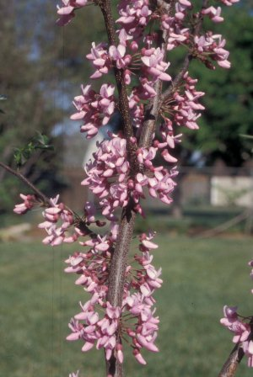
Northern Herald Redbud
This Redbud was released by NDSU. This dense round-headed tree has proven to be winter hardy at this Northern Plains site for at least 40 years. Northern Herald is characterized by quality pink flowers. The quality of it green, leathery-textured, cordate-shaped leaves is also above average for this species. Fruit set is markedly reduced from the species norm.
Height: 15-20’ Spread: 20-30’
Exposure: Full sun to part shade
Zone: 3-8

Slide 25
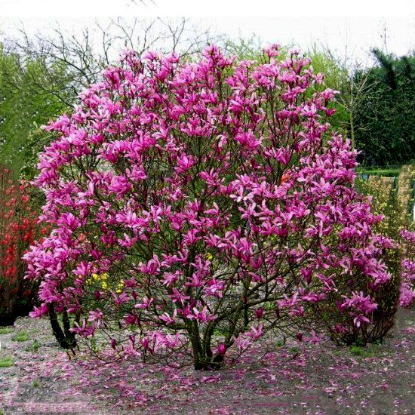
'Susan' Magnolia
This magnolia is a small tree with early spring blooms smothering bare branches. Flowers are upright with deep purple-red backs on the petals, and paler pink-purple interiors. The flowers are 4 inches across when open. Susan Magnolia grow best in cool, moist soil, so mulch over the roots and water during dry spells.
Exposure: Full Sun to Part Shade
Height 8-12’ Spread: 8-12’
Zone: 4-8

Slide 26
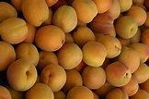
Westcot Apricot
This is a hardy apricot for the backyard orchard with showy pink flowers in early spring followed by tasty yellow fruit blushed red in mid-summer. The fruit is good for jam, fresh eating or canning with a mild sweet flavor. Fruit is about 2” in diameter. It is self-fertile, however will have higher yields with cross-pollination.
Exposure: Full Sun
Height 15-20’ Spread: 12-18’
Zone: 3-8

Slide 27
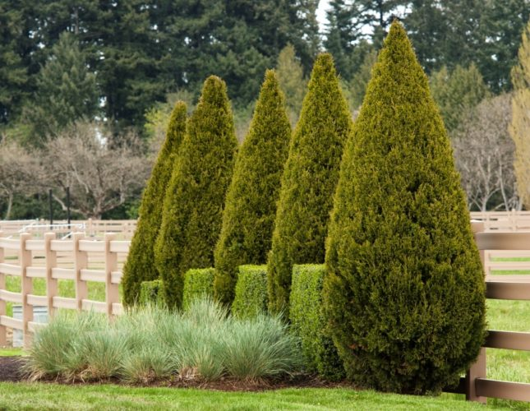
'Spartan' Juniper
This is a handsome, fast growing, columnar selection of Chinese juniper that forms a stately, densely branched bushy conifer with dark green foliage In its natural form, the symmetrical pyramidal shape rarely needs pruning. Is well-suited for use as a formal accent, screen or windbreak.
Height: 20’ Width: 4-10’
Zone: 4-9

Slide 28
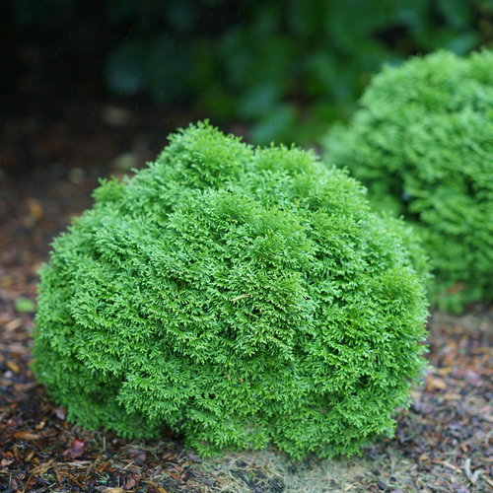
Tator Tot Arborvitae
Tater Tot has a neat, rounded shape and is ideal for sprucing up any space. It is a tidy little globe of fragrant, fan-like evergreen foliage. Provide great winter interest if the snow isn’t too deep.
Exposure: Full Sun to Part Sun
Height: 12-24” Spread: 12-24”
Zone: 3-8

Slide 29
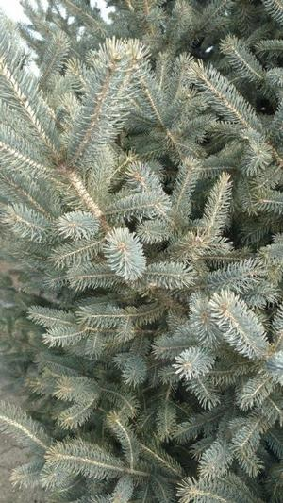
Skinny Blue Genes™ Spruce
Skinny Blue Genes Black Hills Spruce has a dense, conical, narrow growth habit reaching 25 feet and 8 feet wide. With rich blue needles and cold tolerance, it makes an excellent landscape specimen. It is drought and deer tolerant.
Exposure: Full Sun
Height: 25’
Spread: 8’
Zone: 2-8

